Slide 1

CREDIT CARD FRAUD DETECTION USING RANDOM FOREST ALGORITHM
Under the Guidance of
Mr. Ch. Phani Kumar, M.Tech
Assistant Professor
Presented By
P. Sravana Gowri 18NG1A0533
V. Yogna Sri 18NG1A0552
P. Sathvika 18NG1A0537
Y. Sathvik 18NG1A0557

Slide 2
CONTENTS
Introduction
Abstract
Existing system
Proposed system
Requirement Specification
Modules
UML Diagrams
Result
Conclusion

Slide 3
INTRODUCTION
Credit card fraud is increasing day by day. Credit card fraud can be done in both online and offline transactions. In offline transactions Physical cards are required while in online transactions the virtual cards are required for doing illegal or fraud activities. Thus these fraud activities in credit card may lead to many fraud transactions without the knowledge of the actual users. The fraudsters are looking for sensitive information such as credit card number, bank account and other user details in order to perform transactions.
There are many fraud transactions which cannot be easily identified by the user and also by the banking authority which leads to loss of sensitive data. There are various models which are used for detecting the fraud transactions based on the behavior of the transactions and these methods can be classified as two broad categories such as supervised learning and unsupervised learning algorithm. In existing system for finding the accuracy of the fraudulent activates they have used methods such as Cluster Analysis, Support Vector Machine, Naïve Bayer's Classification etc. The aim of this Project is to detect the accuracy of the fraudulent transactions by using Random Forest Algorithm.

Slide 4
ABSTRACT
The project is mainly focused on credit card fraud detection in real world. A phenomenal growth in the number of credit card transactions, has recently led to a considerable rise in fraudulent activities. The purpose is to obtain goods without paying, or to obtain unauthorized funds from an account. Implementation of efficient fraud detection systems has become imperative for all credit card issuing banks to minimize their losses. One of the most crucial challenges in making the business is that neither the card nor the cardholder needs to be present when the purchase is being made. The proposed scheme, using random forest algorithm the accuracy of detecting the fraud can be improved. The performance of the techniques is evaluated based on accuracy, sensitivity, and specificity, and precision.

Slide 5
EXISTING SYSTEM
In existing System, a research about a case study involving credit card fraud detection, where data normalization is applied before Naïve Bayer’s and Cluster Analysis and with results obtained from the use of these methods on fraud detection has shown that by clustering attributes neuronal inputs can be minimized and promising results can be obtained by using normalized data.
This research was based on unsupervised learning. Significance of this paper was to find new methods for fraud detection and to increase the accuracy of results.
The data set for this paper is based on real life transactional data by a large European company and personal details in data is kept confidential. Accuracy of an algorithm is around 50%. Thus the accuracy of the results obtained from these methods are less when compared with the proposed system.

Slide 6
DEMERITS OF EXISTING SYSTEM:
The algorithm has few downsides such as inefficiency to handle the categorical variables which has different number of levels.
Also, when there is an increase in the number of trees, the algorithm's time efficiency takes a hit.

Slide 7
PROPOSED SYSTEM
In Proposed system we use Random Forest Algorithm for classification and regression of dataset.
First we will collect the Credit Card dataset and analysis will be done on the collected dataset.
After the analysis of dataset then cleaning of dataset is required.
Generally in any dataset there will be many duplicate and null values will be present, so to remove all those duplicate and null values cleaning process is required.
Then we have to split the dataset into two categories as Trained dataset and Testing dataset for comparing and analyzing the dataset.

Slide 8
After dividing the dataset we have to apply the Random Forest Algorithm where this algorithm will gives us the better accuracy about the credit card fraud transactions.
By applying the Random Forest Algorithm the dataset will be classified into four categories which will be obtained in the form of confusion matrix.
Based on the above classification of data performance analysis will be done. In this analysis the accuracy of credit card fraud transactions can be obtained which will be finally represented in the form of graphical representation.

Slide 9
MERITS OF PROPOSED SYSTEM:
The random forest ranks the significance of variables in a natural way that Random Forest can be done in a regression or classification problem.
The transaction sum is the 'amount' feature. The 'Class' function is the binary class target, class and takes value 1 for positive cases (fraud) and value 0 for negative situations (not fraud).

Slide 10
REQUIREMENT SPECIFICATION
Software and Packages :
Programming Language : Python
Python IDLE 3.7 or more
Matplotlib
Numpy
Pandas
sklearn
Hardware:
Operating System: Windows 10 or more, linux

Slide 11
MODULES
1. Upload credit Card Data
2. Generate Train and Test Model
3. Run Random Forest Algorithm
4. Detect fraud from the data
5. Visualization graph
First of all, we need to collect data of previous credit card transactions. As the credit card data set is not available because of privacy issues we can use the dataset with time period of two months from Kaggle website. After downloading the dataset in CSV file, Upload credit card dataset.

Slide 12
After Uploading dataset generate Train and Test model for Random Forest Classifier.
After generating model, we can see total records available in dataset and then application using how many records for training and how many for testing. Run Random Forest Algorithm for accuracy.
Now upload a test data contains normal and fraud transactions for prediction. It will detect fraud from the data.
Finally, a graph will appear with the transactions.

Slide 13
USECASE DIAGRAM
upload credit card data
generate train & test model
client
run random forest algorithm
detect fraud form the data
class and fraud transaction
detection graph
Fig: 1 Use Case Diagram

Slide 14
CLASS DIAGRAM
Fig: 2 Class Diagram

Slide 15
SEQUENCE DIAGRAM
Fig: 3 Sequence Diagram

Slide 16
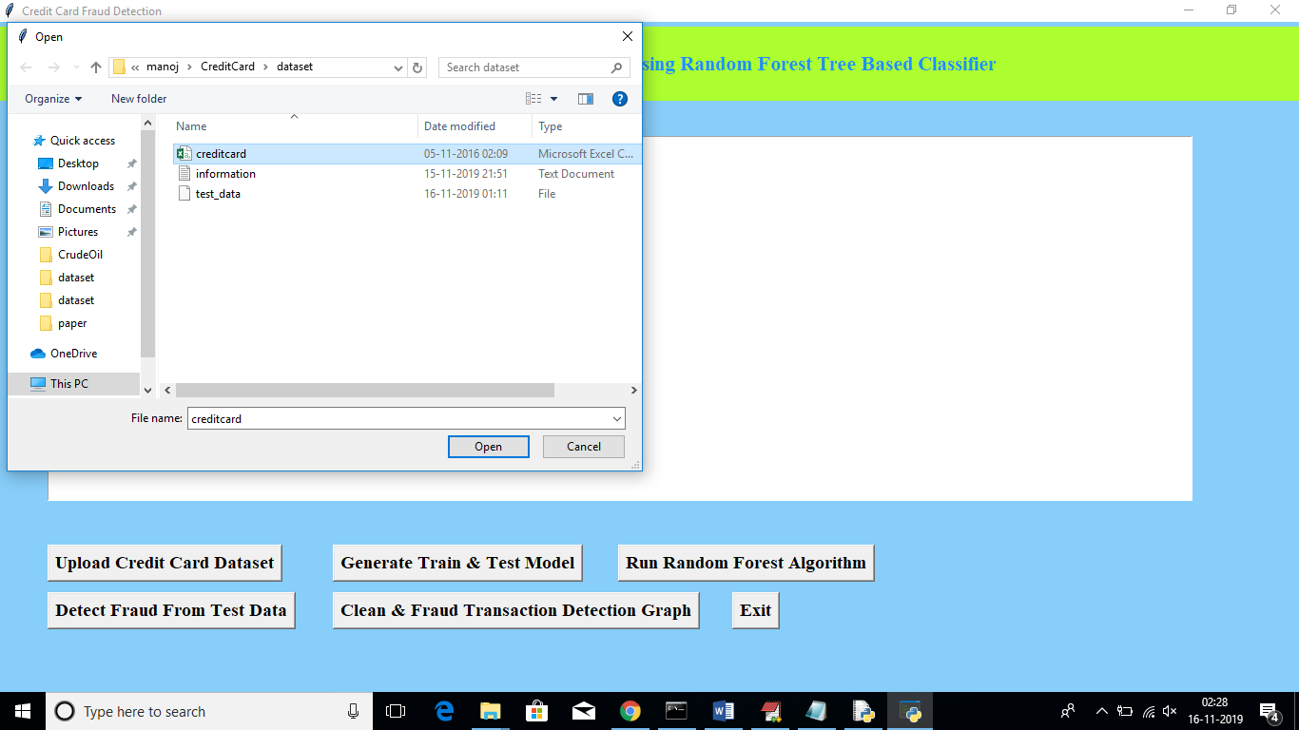
RESULT
Fig: 4 Screenshot of Uploading credit Card Data

Slide 17
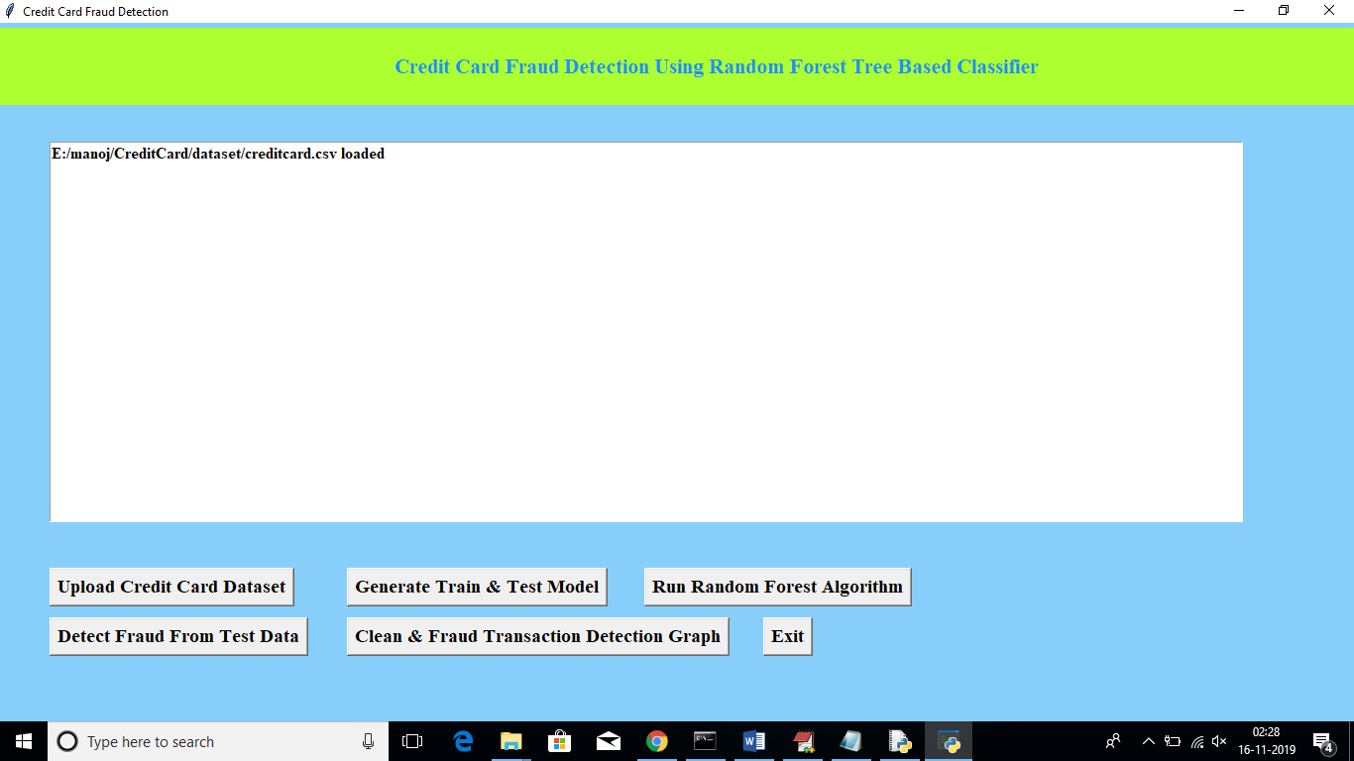
Fig: 5 Screenshot of Generating Train and Test Model

Slide 18
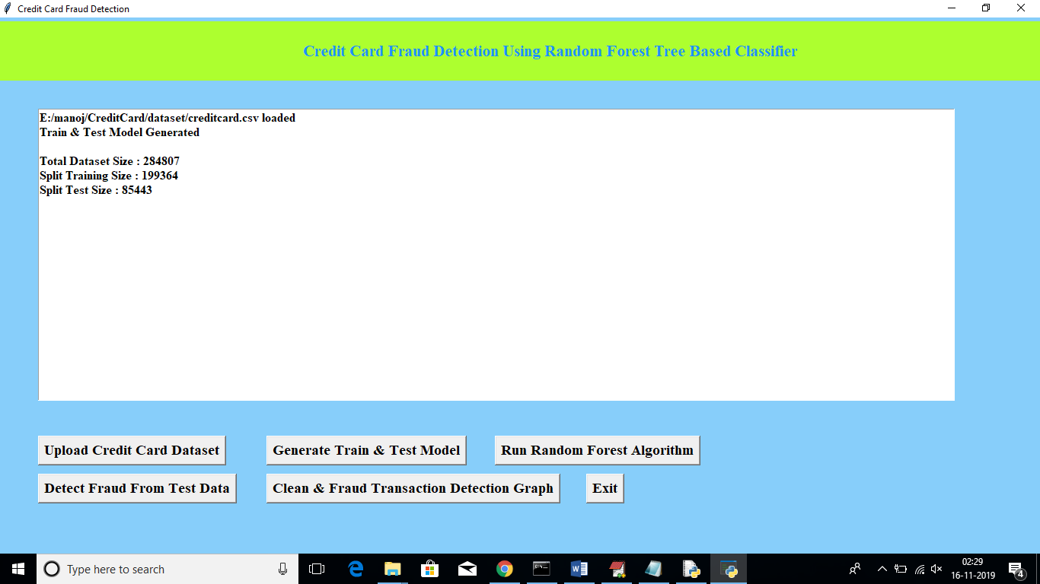
Fig: 6 Screenshot of Running Random Forest Algorithm

Slide 19
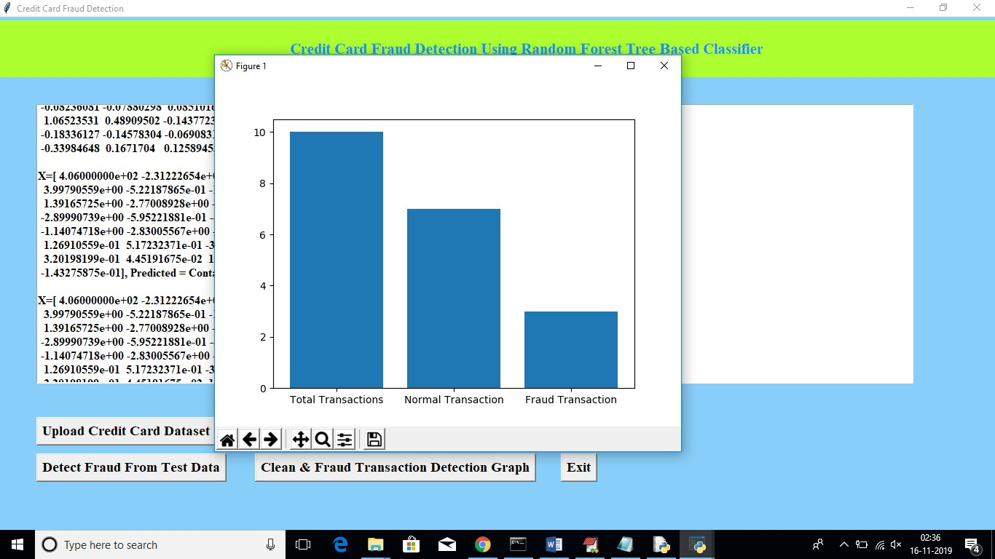
Fig: 7 Screenshot of Detecting Fraud from the Data

Slide 20
CONCLUSION
Random forest algorithm performs well in handling huge amount of highly imbalanced datasets in minimum amount of time. With the accuracy of 99% in the end results it shows significant growth in detecting credit card fraud transactions when compared to the algorithms like decision tree, support vector machines and logistic regression etc., because they are not performed well in handling imbalanced data sets. Random forest solves the overfitting issue by using bunch of decision trees. Random forest considered as the solution for Imbalanced classification.

Slide 21
FUTURE ENHANCEMENTS
In Future, privacy preserving techniques can be applied in distributed environment which will resolve the security related issues preventing private data access.

Slide 22
THANK
YOU

